Slide 1
Electricity Demand and price Forecasting using Machine Learning Techniques
Presented By
Jetti.Pujitha
REG.NO.22471A4213
DEPT. CSE(AI&ML)

Slide 2
CONTENTS
Abstract
Introduction, Objective
Literature review
Methodologies
Result
Conclusion
References

Slide 3
Abstract
This project presents a comparative study of machine learning techniques for electricity demand and price forecasting. A dataset from Kaggle, covering 2106 days, is used to train and test Long Short-Term Memory (LSTM) and Random Forest models. The results show that the LSTM model achieves an accuracy of 96.74%, outperforming the Random Forest model with an accuracy of 94.4%. This study contributes to the development of accurate and reliable models for electricity demand and price forecasting, with implications for improved power grid management, energy trading, and economic planning.
Keywords: Electricity demand prediction, Machine learning algorithms, Energy forecasting.

Slide 4
Introduction
“Electricity demand and price forecasting is crucial for efficient energy management and trading. With the increasing demand for electricity and the integration of renewable energy sources, accurate forecasting has become a challenging task. Traditional forecasting methods are facing significant challenges due to the complexity of energy markets. This project aims to explore the potential of machine learning techniques in improving the accuracy of electricity demand and price forecasting.“
Objective:
The objective of this project is to develop an accurate and reliable predictive model for electricity demand and price forecasting using machine learning techniques, specifically Long Short-Term Memory (LSTM) and Random Forest (RF) models, to improve the efficiency of energy management and trading.

Slide 5
Literature Review
Electricity demand and price forecasting has been an active area of research in recent years. Various studies have explored different approaches to improve the accuracy of forecasting models.
Traditional Methods:
Early studies on electricity demand forecasting used traditional methods such as autoregressive integrated moving average (ARIMA) models, exponential smoothing (ES) models, and regression analysis . These methods have been widely used due to their simplicity and ease of implementation. However, they have limitations in handling non-linear relationships and complex patterns in data.

Slide 6
MACHINE LEARNING METHODS: In recent years, machine learning techniques have gained popularity in electricity demand and price forecasting. Studies have shown that machine learning models such as artificial neural networks (ANNs), support vector machines (SVMs), and random forests (RFs) can outperform traditional methods in terms of accuracy . These models can handle non-linear relationships and complex patterns in data, making them well-suited for electricity demand and price forecasting CONCLUSION: The literature review highlights the growing interest in applying machine learning and deep learning techniques to electricity demand and price forecasting. While traditional methods have limitations, machine learning models have shown promising results in improving forecasting accuracy. This study aims to contribute to the existing literature by exploring the potential of LSTM and RF models in electricity demand and price forecasting

Slide 7
Methodologies
Data Description
The dataset used in this project is from Kaggle,covering 2106 days between 1st January 2015 to 6th October 2020. The data set contains 14 columns, including:
Data
Demand
RRP
Demand _pos _ RRP
RRP_ negative
Demand _ neg _ RRP
RRP _ Positive
Frac _at _ neg _RRP
Min _temperature
Max_ temperature
Solar_exposure
Rainfall
School _ day
Holiday

Slide 8
Data Preprocessing
The dataset is preprocessed by converting the date column into day, month, year, and day of the week. The values are then scaled using the Min-Max Scaler, handled missing values, encoded categorical values. And after preprocessing total number of columns are 18
Data Visualisation
To better understand the relationships between variables, I created various plots, including:

Slide 9
Scatter plots to visualize demand vs. max-temperature and demand vs. RRP, demand vs. solar exposure.
Box plot to analyze demand by day of a week, demand on school days vs. holidays.
Joint plots to examine relationship between demand vs. RRP.
Histograms to analyze the distribution of demand and temperature values.
Correlation heat map.
These visualizations provided valuable insights into the data and informed our modeling decisions.

Slide 10
Feature Engineering
The dataset is split into training and testing sets using the train _ test _ split function from Scikit -learn.
Model Implementation
Two machine learning models, LSTM and Random Forest, are implemented and compared.
LSTM:
LSTM stands for Long Short Term Memory
LSTM is a type of Recurrent Neural Network (RNN) that is designed to handle the vanishing gradient problem in traditional RNNs. LSTMs are particularly well-suited for modeling temporal relationships in data, such as time series data.
The LSTM model is implemented using the Keras library. The model consists of an input layer, a LSTM layer, and an output layer.

Slide 11
Random Forest:
The Random Forest model is implemented using the Scikit-learn library. The model consists of an ensemble of decision trees.
Random Forest is a supervised learning algorithm that combines multiple decision trees to produce a more accurate and robust prediction model.
It is an ensemble learning method that works by constructing multiple decision trees during training and outputting the class that is the mode of the classes (classification) or mean prediction (regression) of the individual trees.
The Random Forest algorithm has several hyperparameters that can be tuned to optimize its performance.
These include the number of decision trees, the maximum depth of each tree, and the number of features to consider at each split.

Slide 12
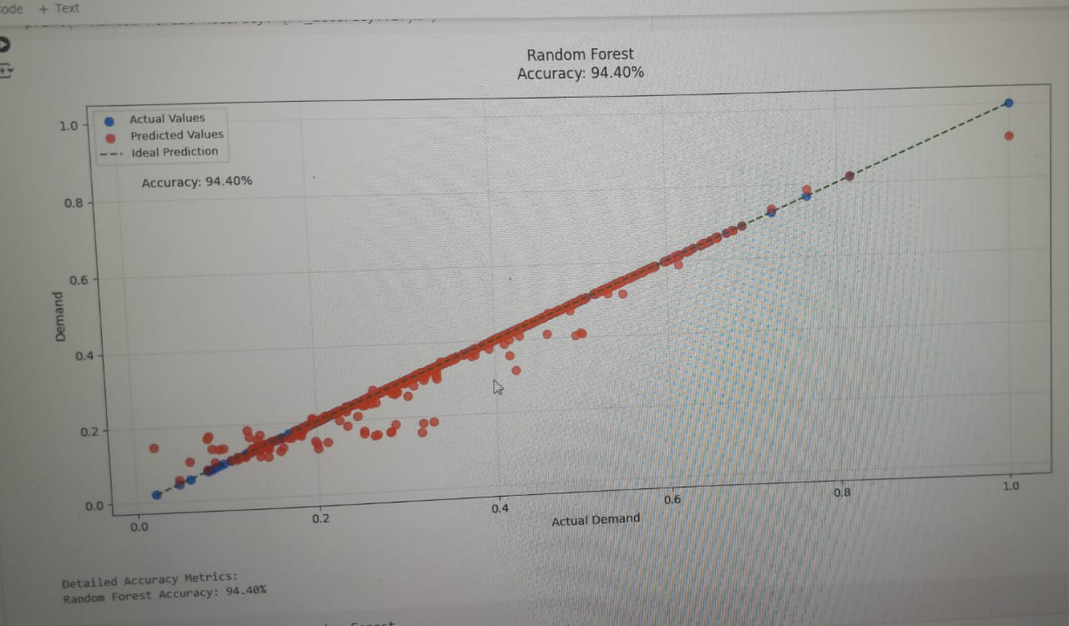
Result of Random Forest
Evaluation Metrics
Metric Values
MAE-0.009243488
MAPE-5.597700575
R^2 -0.97172059217
RMSE-0.02579103553
Accuracy:94.40229942
Actual vs. Predicted Demand
X-axis: Actual Demand
Y-axis: Predicted Demand
Plot Type: Scatter Plot

Slide 13
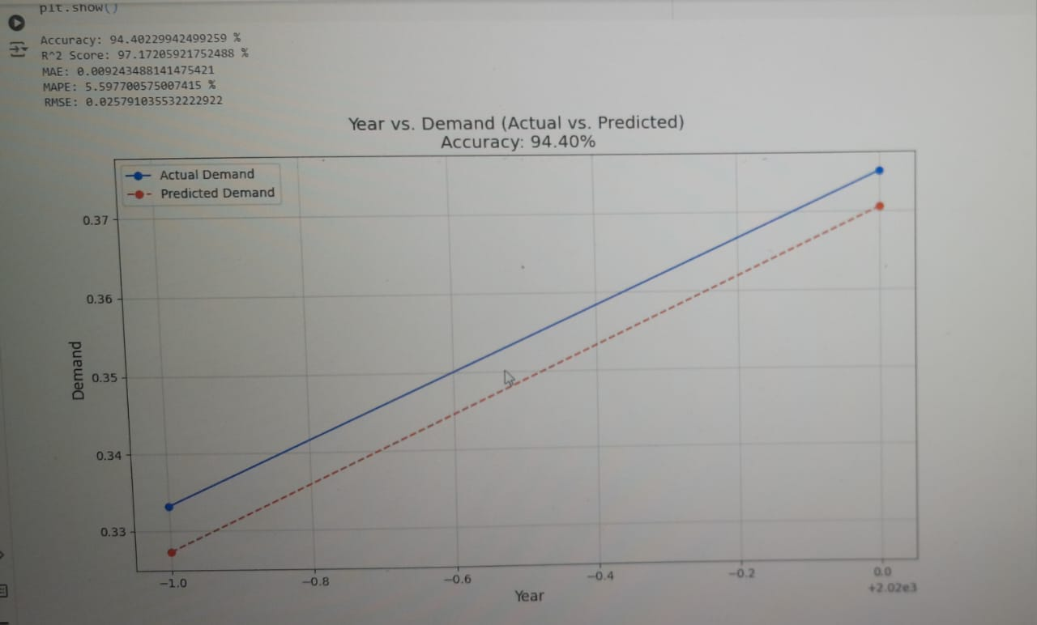
Yearly Demand Trend
[Insert Plot:
X-axis: Year
Y-axis: Demand
Plot Type: Line Plot

Slide 14
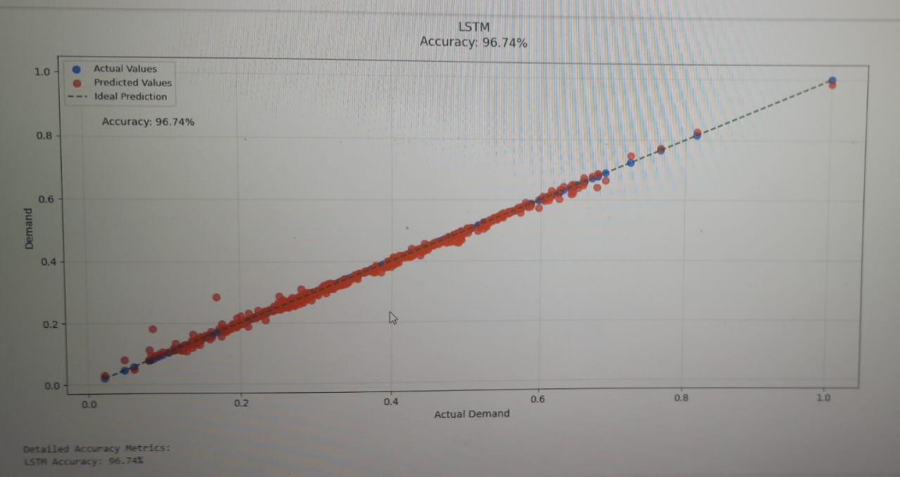
RESULTS OF LSTM
Evaluation Metrics
Metric values:
MAE-0.0077986844
MAPE-3.258611007
R^2 -0.999366413637
RMSE-0.0122077755
Accuracy:96.741388992
Actual vs. Predicted Demand
X-axis: Actual Demand
Y-axis: Predicted Demand
Plot Type: Scatter Plot

Slide 15
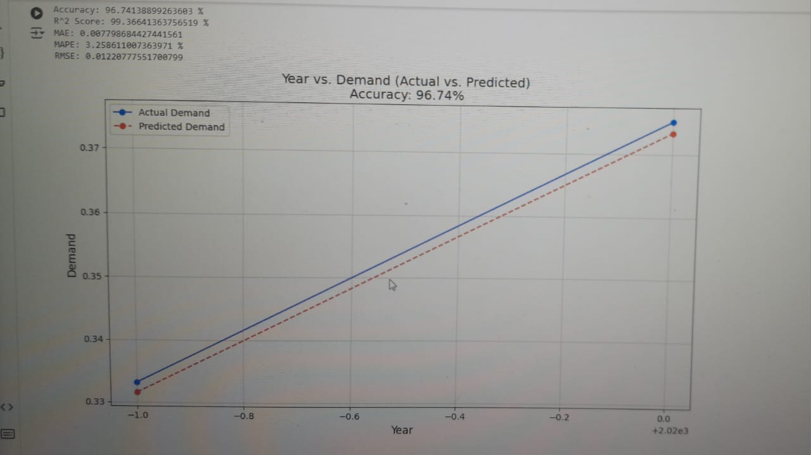
Yearly Demand Trend
[Insert Plot: Year vs. Demand
X-axis: Year
Y-axis: Demand
Plot Type: Line Plot

Slide 16
Conclusion
Summary of key findings:
The LSTM model achieves an accuracy of 96.74%, outperforming the Random Forest model with an accuracy of 94.4%.Implications and Recommendations. The results of this study have implications for utilities and policymakers. The use of machine learning models, such as LSTM, can improve the accuracy of electricity demand and price forecasting, leading to more efficient resource allocation and pricing.
 | Random forest | LSTM
MAE | 0.0092434 | 0.0077986
MAPE | 5.597700 | 3.258611
R^2 | 0.9717205 | 0.9993664
RMSE | 0.0257910 | 0.01220777
Accuracy | 94.40229 | 96.741388

Slide 17
References
S. S. Rao, S. K. Singh, and R. K. Singh, "Electricity Price Forecasting using Machine Learning Models," in IEEE Transactions on Power Systems, vol. 34, no. 2, pp. 1431-1 440, March 2019.
Y. Chen, Y. Zhang, and J. Li, "Short-Term Electricity Demand Forecasting using LSTM Networks," in IEEE Transactions on Neural Networks and Learning Systems, vol. 30, no. 1, pp. 201-212, January 2019.
S.Raza and R. Khera, "Price and demand forecasting in electricity markets using machine learning techniques," Renewable and Sustainable Energy Reviews, vol. 135, pp. 110256, 2021.

Slide 18


